Slide 1

PUTTING ROCK, PAPER, SCISSORS TO THE TEST

Slide 2
PRESENTED BY
Rahul chowdary
Pooja M
Aliya S
Narayana
Nithi Shree
Niranjana
Pramod R
Rohan GB
Rohit Sadanandan
Saasvatha
Santhosh Kumar K
Shivanand S N
Shubham A
Sujjit D S

Slide 3
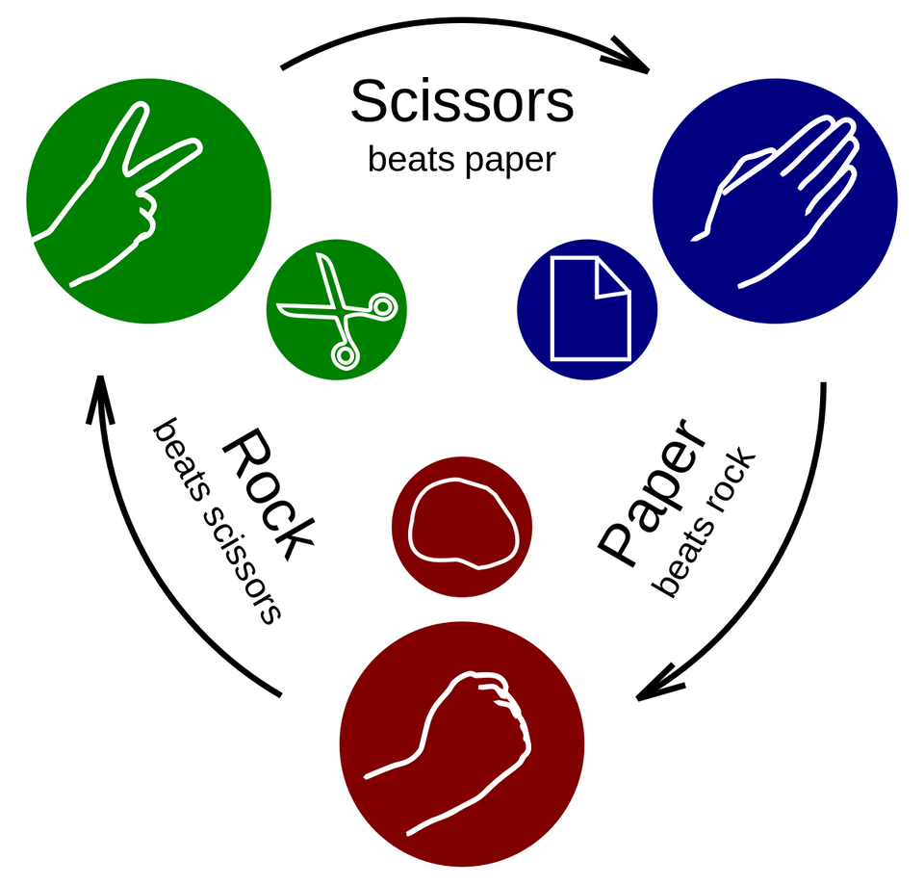
What is rock paper scissors?
Rock, Paper, Scissors is a hand game played between two people. Each player simultaneously chooses one of three shapes: rock, paper, or scissors. The winner is determined by the rules: rock crushes scissors, scissors cut paper, and paper covers rock.

Slide 4
How do we go about testing?
1
2
3
4
5
Understand the game mechanics thoroughly.
Identify and list various test scenarios.
Prioritize scenarios based on importance.
Develop a comprehensive test plan.
Review and iterate based on feedback.

Slide 5
Requirement Analysis
Technical
Non-Technical
1. Players can play against the computer.
2. Players choose Rock, paper, or scissors.
3. The computer randomly selects its move.
4. Winner is determined by the rules:
- Rule 1: Rock beats scissors.
- Rule 2: Paper beats rock.
- Rule 3: Scissors beat paper.
- Rule 4: A tie occurs if both players choose the same gesture.
5. The game tracks the score, with the winning point set at 10.
6. Results of each round (win, lose, or draw) are displayed.
What is 5G Technology?
Able to play on any platform (i.e Windows, MacOS, Android)
Able to handle a larger number of audience at the same time
Should be reliable and handle error or crashes
5G is the fifth generation of wireless network technology. It offers faster download and upload speeds and allows for more connected devices at the same time.

Slide 6
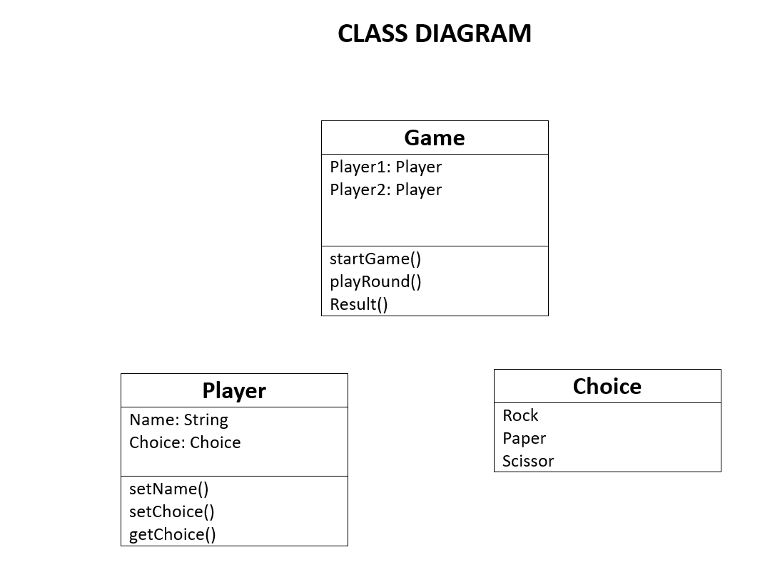
Understanding Class Diagram

Slide 7
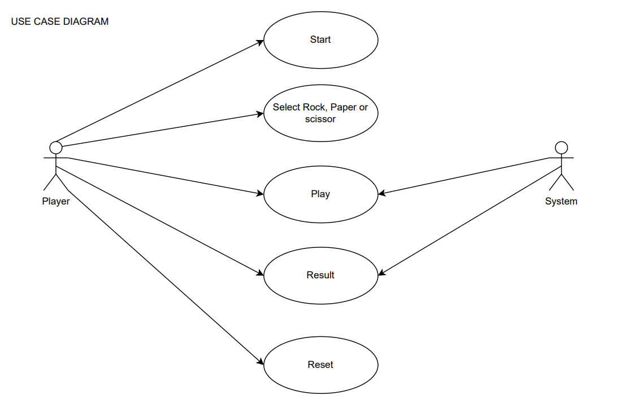
Use Case Diagram

Slide 8
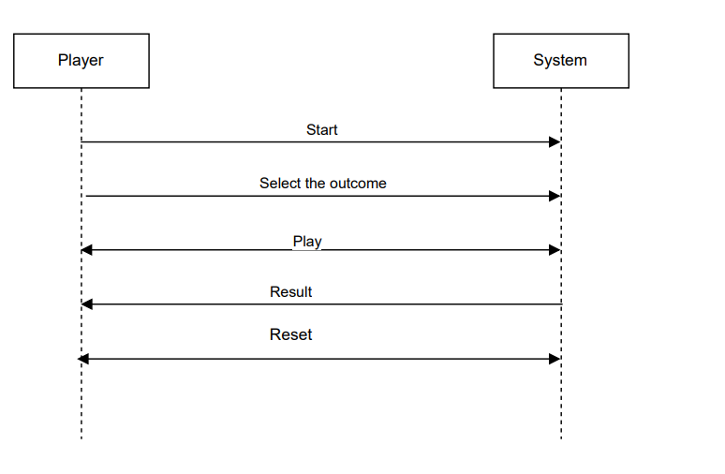
Sequence Diagram

Slide 9
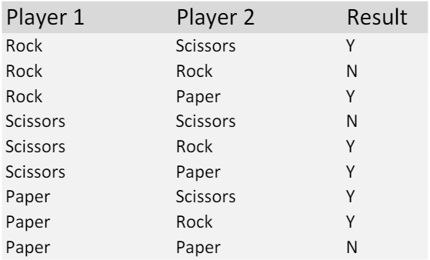
Decision Table

Slide 10
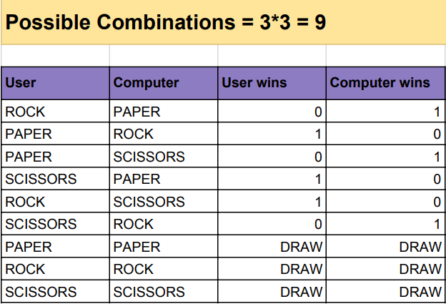
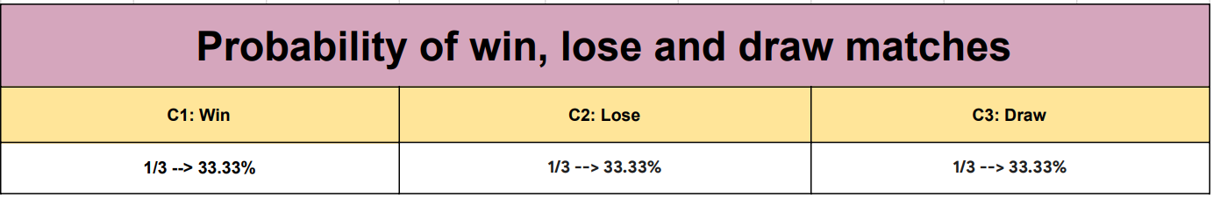
Equivalence Partitioning

Slide 11


White Box Testing
Black Box Testing
Test’s application functionality without looking internal code.
Inputs: Outputs: System behavior:
Example:
Input: Player one chooses Rock; Player two chooses scissor;
Expected output: Player two wins.
Input: Player one chooses paper; Player two chooses paper;
Expected output: TIE.
Examining internal structure, logics, paths within code to design test cases.
Example:
Path Coverage Test: Ensure that all possible paths through the code are exercised.
Validate that the game handles boundary conditions and edge cases, such as invalid inputs and extreme choices. (3!=6 possible outcomes)

Slide 12

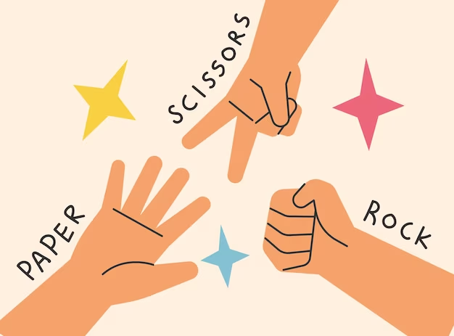
Testing Strategy
Make sure the software works as expected by carefully planning tests and carrying them out with great care.
Example:
Game Reset:
Objective: Verify game's ability to reset.
Steps:
Play a round of the game.
Initiate game reset.
Outcome: Game resets, ready for a new round with fresh player choices.

Slide 13
CDT- Combinatorial Driven Testing
In the game of rock-paper-scissors, there are 3 choices (rock, paper, scissors), that gives us a total combinations of 3 * 3 = 9 and if there’s some other kind of possible combinations when two players make their selections.
But using CDT let’s cut down the tests to make our work easier

Slide 14

Test Results
Test Factors
Action1: Rock, Paper, Scissor
Action2: Rock, Paper, Scissor
Winner: Tie, Rock, Paper, Scissor
if [Action1] = [Action2] then [Winner] = "Tie";
if [Action2] = "Rock" and [Action1] = "Scissor" then [Winner] = "Rock";
if [Action2] = "Paper" and [Action1] = "Scissor" then [Winner] = "Scissor";
if [Action2] = "Paper" and [Action1] = "Rock" then [Winner] = "Paper";
if [Action2] = "Scissor" and [Action1] = "Rock" then [Winner] = "Rock";
if [Action2] = "Scissor" and [Action1] = "Paper" then [Winner] = "Scissor";
if [Action2] = "Rock" and [Action1] = "Paper" then [Winner] = "Paper";
Action1 | Action2 | Winner
Rock | Rock | Tie
Paper | Scissor | Scissor
Scissor | Rock | Rock
Scissor | Scissor | Tie
Paper | Rock | Paper
Scissor | Paper | Scissor
Rock | Paper | Paper
Rock | Scissor | Rock
Paper | Paper | Tie

Slide 15
Do you have
any questions?

